Slide 1





Inference of demographic histories and distributions of fitness effects of deleterious mutations from human gut microbiomes
Jonathan Mah
Lohmueller and Garud Labs
September 26th, 2023
@jonmah_compbio
jonmah@g.ucla.edu
Notes:
How’s it going guys, gals, and non-binary pals, my name is Jonathan Mah, I’m a PhD student coadvised by Professor Kirk Lohmueller and Professor Nandita Garud, and time permitted, today I’ll be talking about my #soon to be submitted work concerning inference of demography and selection in the human gut microbiome. But before we begin, I’d like to start off with a quick story about... I know we’re all thinking it… That’s right, you guessed it… →

Slide 2
The US National Census
Notes:
The US National Census.
Here is how this works.
Every 10 years →

Slide 3

The US National Census
Notes:
The government sends a bunch of people with clipboards to ask questions, such as how many people are living, what kind of people are they, and where do they live.

Slide 4

The US National Census
Notes:
This information is used to distribute voting power in the House of Representatives, so to some extent it does have fairly meaningful consequences.

Slide 5
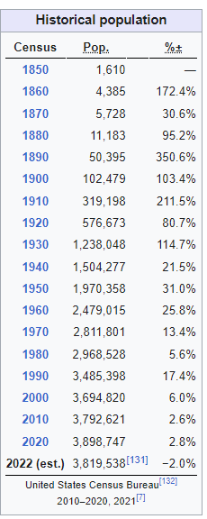
How do population sizes change over time?
Expansion
Notes:
As an example, let’s consider Los Angeles. One of the things that the census tracks is how population sizes change over time. Here, from the census, we can see that as of the year 2000, Los Angeles had a population of about 3.7 million people, increasing to 3.8 and then 3.9 million in the following decades.

Slide 6
How do population sizes change over time?
Expansion
Why?
Notes:
If you’re like me, and politics fills you with dread, then you might want to know why.

Slide 7
How do population sizes change over time?
Expansion
Why?
Beautiful weather
Great food
The Dodgers
Notes:
There are plenty of reasons why more people want to live in Los Angeles: We have beautiful weather, we have great food, and the Dodgers even won the world series in 2020.

Slide 8
How do population sizes change over time?
Expansion
Contraction
Why?
Beautiful weather
Great food
The Dodgers
Notes:
However, the census also lets us know that, relative to 2020, Los Angeles has instead seen a decrease in estimated population size, as of 2022.

Slide 9
How do population sizes change over time?
Expansion
Contraction
Why?
Why?
Beautiful weather
Great food
The Dodgers
Notes:
If you’re like me and politics fills you with dread, then you might want to know why.

Slide 10

How do population sizes change over time?
Expansion
Contraction
Why?
Why?
Beautiful weather
Great food
The Dodgers
COVID-19
Cost of Living
The Angels except for Shohei Ohtani and Mike Trout
ohtani please join the mariners
Notes:
There are plenty of reasons why there are fewer people living in Los Angeles: Covid-19, the high cost of living, and our other baseball team, The Angels.

Slide 11

We gain insight into demographic trends over time
How many people live in Los Angeles?
Notes:
Altogether, the Census gives us important insights into demographic trends, which have real, tangible effects on our lives.
What I do, is very similar, except instead of asking “How many people live in Los Angeles”, I ask

Slide 12

We gain insight into demographic trends over time
How many people live in Los Angeles?
How many bacteria live in people?
Notes:
How many bacteria live in people?

Slide 13
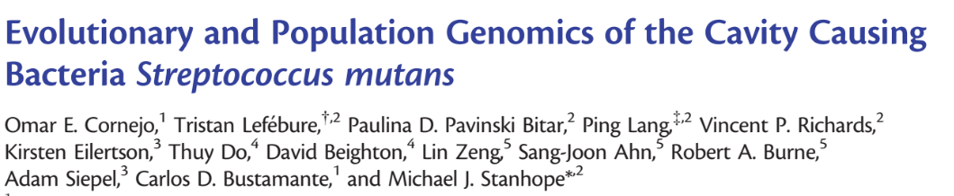
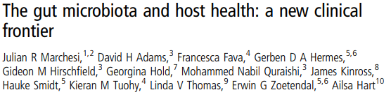
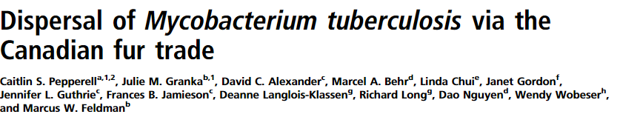
We gain insight into demographic trends over time
How many people live in Los Angeles?
How many bacteria live in people?
Notes:
And if you’re like me, and bacteria fills you with bacteria, then you might want to know why.

Slide 14
We study the Human Gut Microbiome
Notes:
Our system of study is the bacteria that live in, on, and around us, otherwise known as the Microbiome. In particular, I study the bacteria present in our guts

Slide 15
We study the Human Gut Microbiome
Notes:
Here is a simple cartoon schematic of a person and their bacteria, with these lines on the right-hand side representative of bacterial genomes.

Slide 16
We study the Human Gut Microbiome
Ruminococcus bromii
Notes:
Let’s take for example, one species: Ruminococcus bromii

Slide 17
We study the Human Gut Microbiome
Ruminococcus bromii
Typically, 1-4 strains per species per host
Notes:
Now, you might notice that not all of these lines are the same color – this is to represent the observation that typically, there are between 1 and 4 strains of each bacterial species per host, that is to say that the strains in my body are different from the strains in your body. The Human Gut Microbiome presents an extremely complicated system in which we can ask fundamental basic science questions about evolution and ecology.

Slide 18
How do demographic metrics, such as nucleotide diversity, differ by geography?
Notes:
Thus, we began our investigation by asking how nucleotide diversity might differ by geography

Slide 19
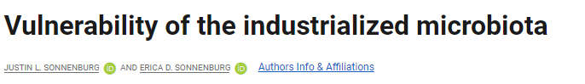
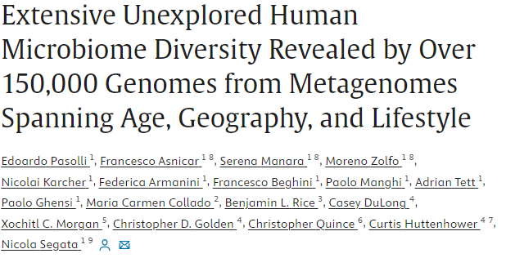
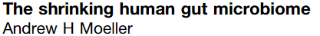
How do demographic metrics, such as nucleotide diversity, differ by geography?
Notes:
There is a fairly substantial body of work suggesting that the microbiomes of people living in urbanized, industrialized, westernized societies have seen general reductions in microbiome diversity at the of level species, genes and nucleotide diversity

Slide 20

How do demographic metrics, such as nucleotide diversity, differ by geography?
Notes:
This is important in the context of human health because such depletions in diversity are associated with certain negative or deleterious health outcomes, such as increased susceptibility to infectious, developmental, and chronic diseases

Slide 21
We compute nucleotide diversity
Notes:
Here is how we approached this.
We used fecal shotgun metagenomic sequencing data to investigate population genetics questions in the human gut microbiome.
More informally, instead of “population genetics”, we like to call this work “Poopulation genetics”

Slide 22
We compute nucleotide diversity
Within hosts
Between hosts
Notes:
We computed the nucleotide diversity both within hosts and between hosts for several bacterial species present in at least one of two Cohorts:

Slide 23
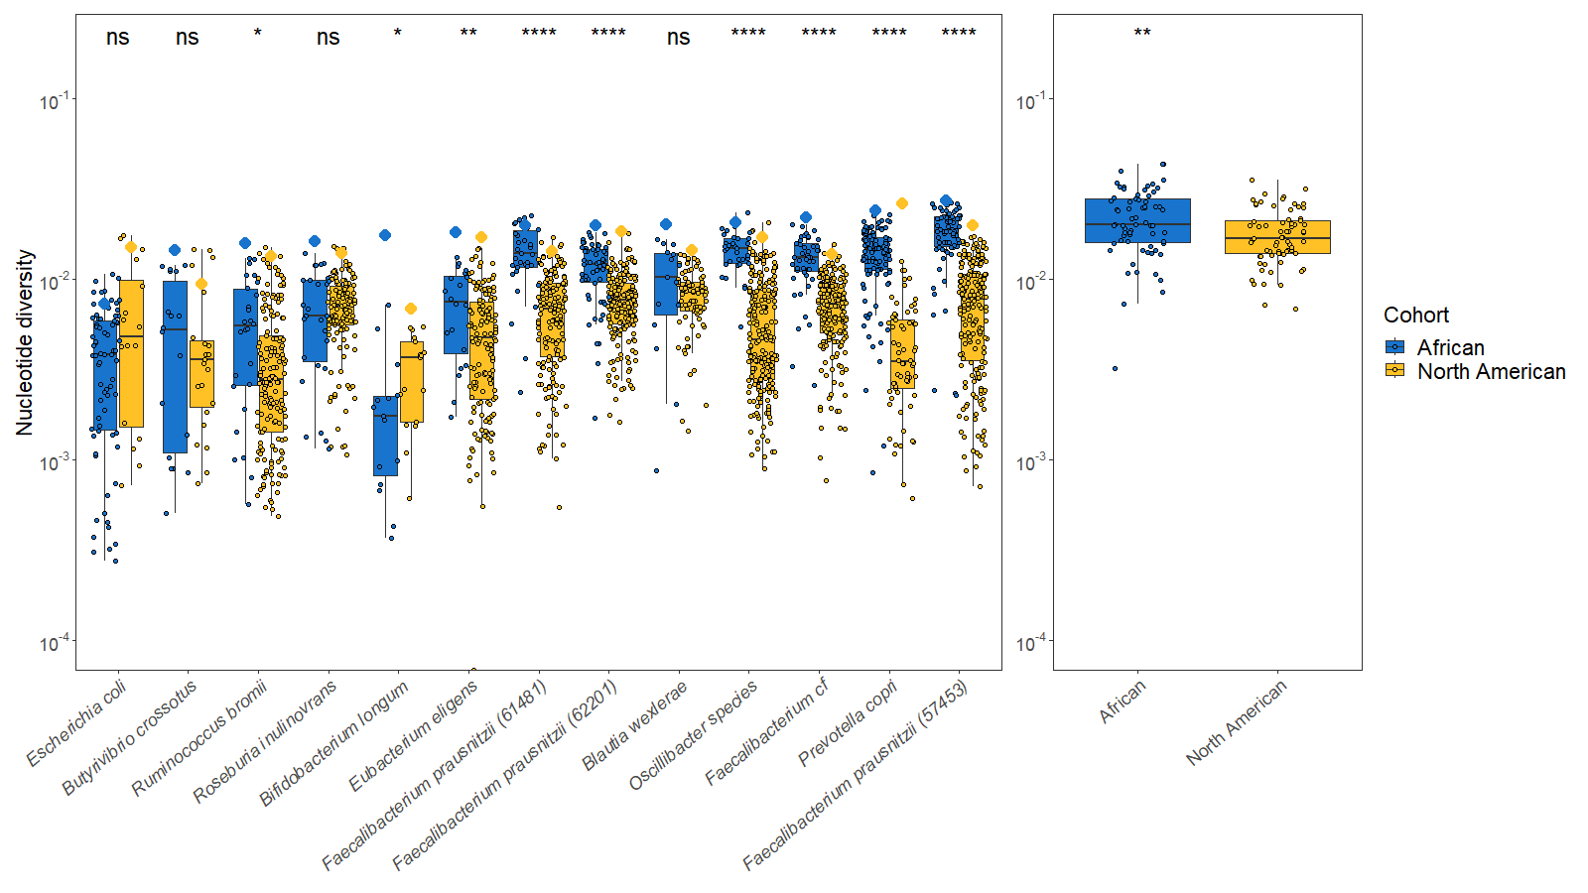
We compute nucleotide diversity
Within hosts
Between hosts
Notes:
one from a rural African population, and another from an urbanized North American population. Let’s take a closer look at the data

Slide 24
How do demographic metrics, such as nucleotide diversity, differ by geography?
A
B
Notes:
Hey, it’s our old friend Ruminococcus bromii! I’ve separated the data by cohort, with the African gut microbiomes shown in blue and the North American gut microbiomes shown in yellow. Each smaller circle represents the within-host nucleotide diversity of a single person, with the box and whiskers representing the distribution.

Slide 25
How do demographic metrics, such as nucleotide diversity, differ by geography?
A
B
Notes:
Separately, I show larger diamonds, also color-coded and typically found above the distribution of smaller circles. This represents the average across-host nucleotide diversity, computed in a pairwise fashion.

Slide 26
How do demographic metrics, such as nucleotide diversity, differ by geography?
A
B
Notes:
We’ve computed this for all species which were present in at least 5 hosts in both cohorts

Slide 27
How do demographic metrics, such as nucleotide diversity, differ by geography?
A
B
Notes:
Quite interestingly, by means of a unpaired two-sided Wilcoxon rank sum test, the difference between the distribution of African and North American within-host diversity is statistically significant in 9 out of 13 species after controlling for false discovery rate

Slide 28
How do demographic metrics, such as nucleotide diversity, differ by geography?
A
B
Notes:
Here on the right we show the mean across-host nucleotide diversity of all species present in either cohort irrespective of overlap, and again, quite interestingly, we find a statistically significant depletion in nucleotide diversity in North American gut microbiomes relative to African gut microbiomes via a two-sided Wilcoxon rank-sum test

Slide 29
How many bacteria live in people?
Notes:
Next we turned our attention towards quantifying how many bacteria live in people. Given our findings of depleted nucleotide diversity, we focused the remainder of our analysis on North American gut microbiomes.

Slide 30
How many bacteria live in people?
One strain per species
per host
Notes:
We’re interested in gut microbiome diversity across human populations, so our data is constrained to only the most prominent strain of each species per host

Slide 31
We compute the site-frequency-spectrum
One strain per species
per host
30.00%
22.50%
Proportion of variants
15.00%
7.50%
0.00%
1 2 3 4
5
6
7
8
Mutation class (Singletons, doubletons, tripletons, etc.)
Notes:
We leverage a summary statistic of genetic variation known as the site frequency spectrum, which we can visualize here as a histogram by which the x-axis tells us how rare or common a mutation is and the y-axis denotes the proportion of mutations which fall into each level of rarity

Slide 32
We compute the site-frequency-spectrum
One strain per species
per host
30.00%
22.50%
Proportion of variants
15.00%
7.50%
0.00%
1 2 3 4
5
6
7
8
Mutation class (Singletons, doubletons, tripletons, etc.)
Notes:
As an example for how to read this, this 1st bar refers to singletons, which are mutations which only manifest once in a population

Slide 33
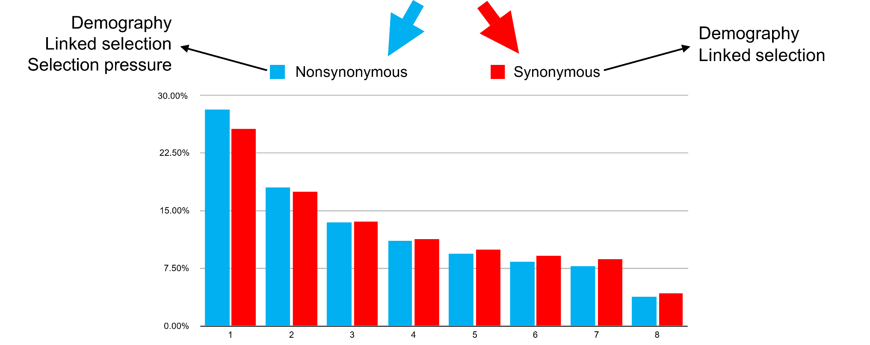
We split the site-frequency-spectrum into synonymous and nonsynonymous variants
30.00%
22.50%
Proportion of variants
15.00%
7.50%
0.00%
1 2 3 4
5
6
7
8
Mutation class (Singletons, doubletons, tripletons, etc.)
Notes:
Further, we can split this purple, bipartisan, SFS into putatively neutral synonymous mutations (shown here in red), and assumed negatively selected nonsynonymous mutations (shown here in blue).
The SFS is known to be subject to three major classes of evolutionary forces, being demography, linkage, and selection.

Slide 34
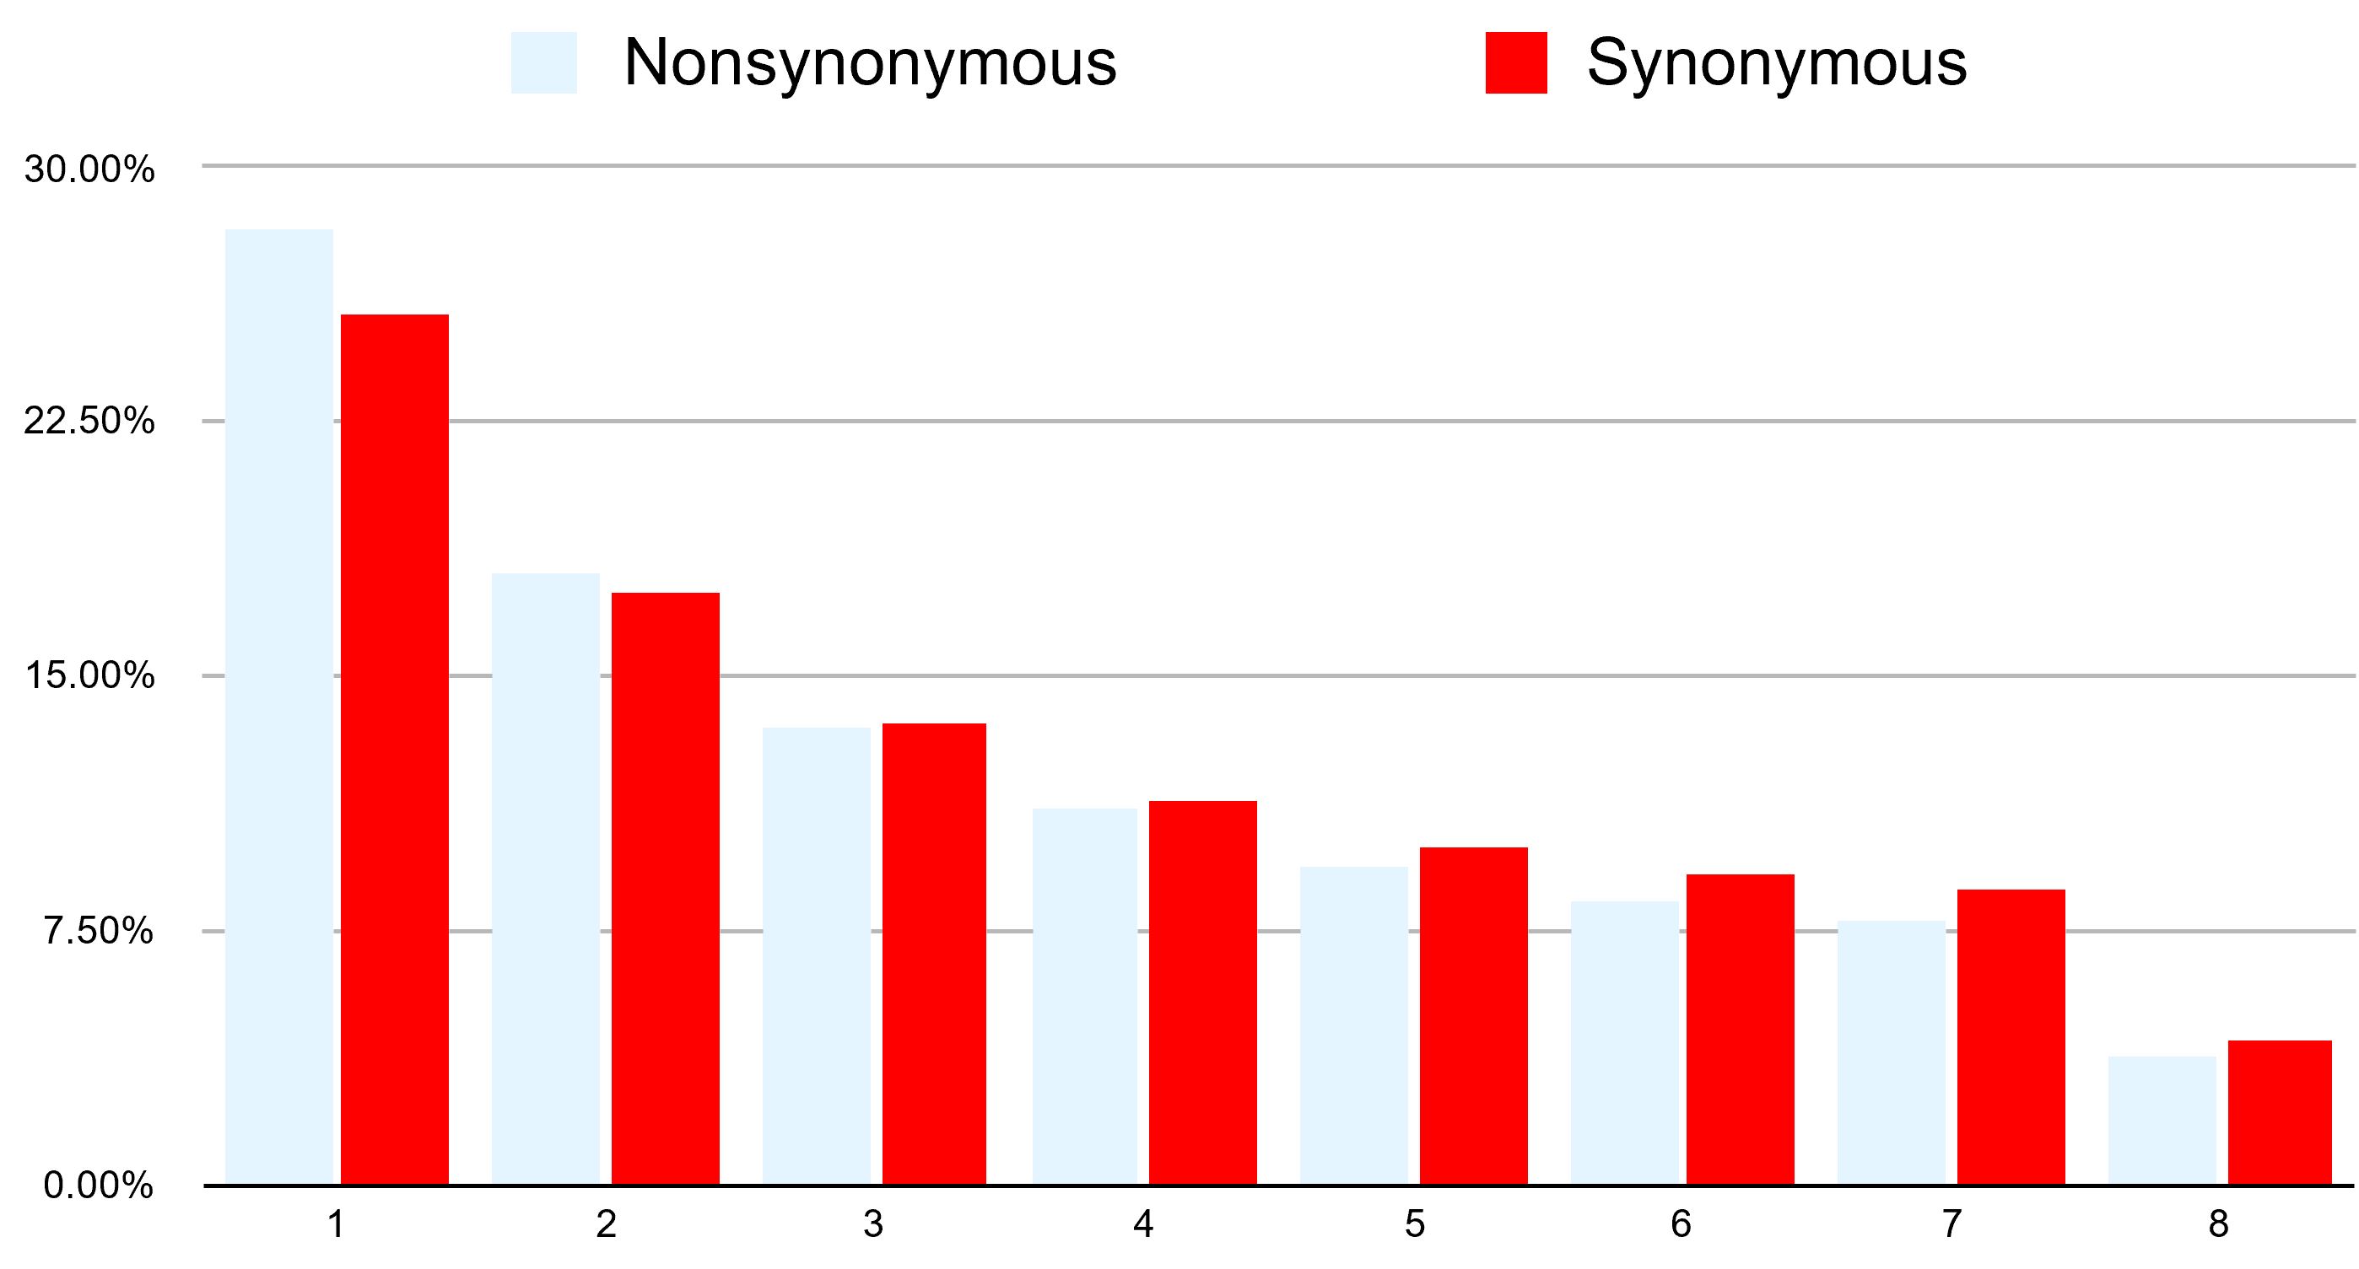
We use Dadi to infer demographic history
Demography
Linked Selection
Notes:
Note that, since we’re working with Bacteria, which have an extremely high rate of recombination, we can to some extent ignore linkage. Thus, our synonymous, red, SFS is almost entirely subject to the effects of Demography, which we can infer.

Slide 35
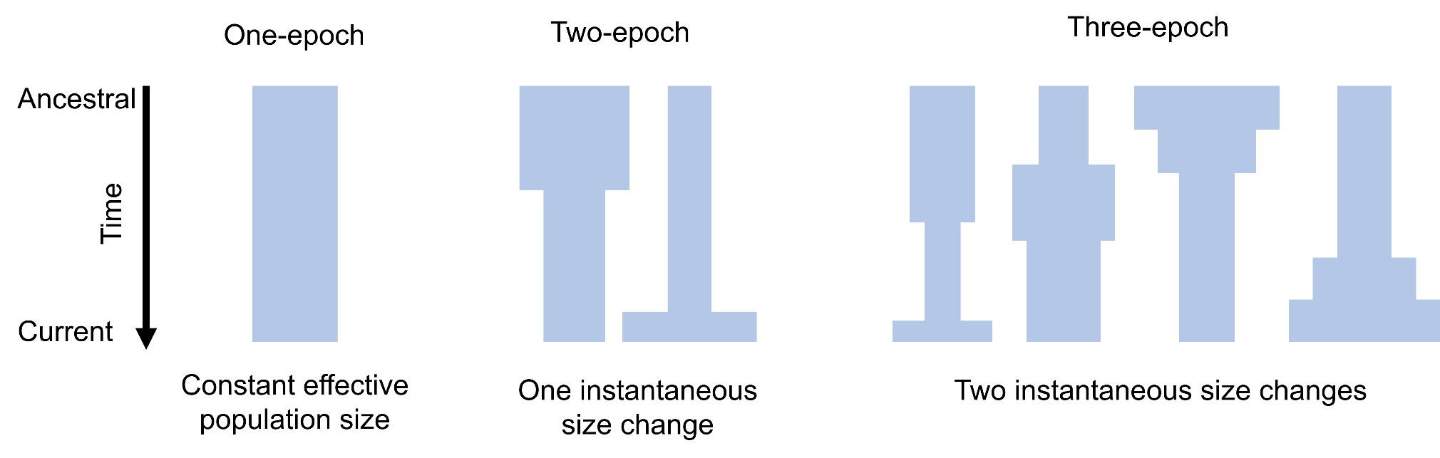
We use Dadi to infer demographic history
Demography
Linked Selection
Notes:
We use a statistical inference package known as Dadi to infer demographic models from the synonymous SFS. On the right here I show several different cartoon schematics for different model specifications. The width of each schematic corresponds to the effective population size at the time.

Slide 36
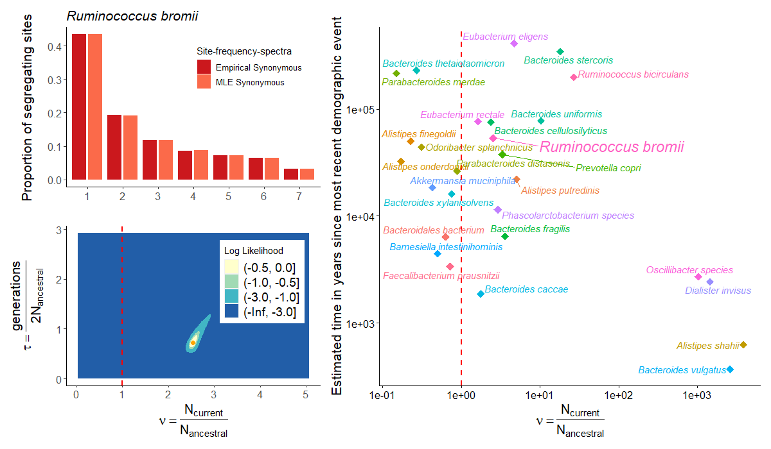
We infer varied demographic histories
Notes:
Let’s proceed by walking through an example. Here I show the synonymous site-frequency spectrum of our old friend, Ruminococcus bromii.
In darker colors we show the empirical data, while in lighter colors we show the spectrum simulated under our demographic model.

Slide 37
We infer varied demographic histories
Notes:
Speaking of, the way we fit these model is by exploring a 2-parameter likelihood surface using a gradient descent based approach. Our two parameters are “nu”, shown along the x-axis, which represents a ratio of current to ancestral population size,

Slide 38
We infer varied demographic histories
Notes:
And “tau”, shown on the y axis, representing the amount of time which passes in an epoch, in units of generations per 2 times the ancestral population size.

Slide 39
We infer varied demographic histories
Notes:
A difference of three log likelihoods approximates a 95% confidence interval.
In summary, the model parameters which simulate a model SFS most closely fitting the observed data is assumed to represent the underlying evolutionary history.

Slide 40

We infer varied demographic histories
Notes:
Want to see me do it again?

Slide 41
We infer varied demographic histories
Notes:
We did, for 27 bacterial species simultaneously across the human gut microbiome. Here, on the right, I’m showing a summarizing scatterplot where the x-axis is identical to the likelihood surface, and the y-axis is converted to actual units of time in years.

Slide 42
We infer varied demographic histories
Contraction
Expansion
Notes:
I’d like to highlight this dotted red line on both the likelihood surfaces and the scatterplot, which separates the parameter space between contractions. We find that bacteria are inferred to have varied demographic histories.

Slide 43
We infer varied demographic histories
Notes:
I’d like to note that this time frame of around 10,000 years is quite meaningful within the context of human history.

Slide 44
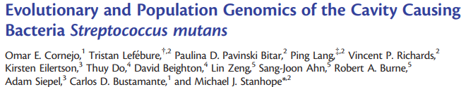
We infer varied demographic histories
Notes:
A similar study by Omar Cornejo et al. found a population demographic expansion in the cavity causing oral pathogen, Streptococcus mutans, on a time scale roughly coincident with the onset of human agriculture 10,000 to 20,000 years ago, in part due to increased ecological niche availability as a consequence of the shift in diet

Slide 45
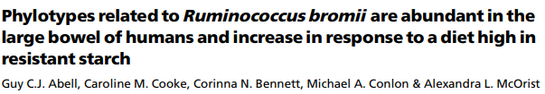
We infer varied demographic histories
Why?
Notes:
Perhaps something similar is happening with Ruminococcus bromii, which also sees an expansion on a timescale roughly coincident with human agriculturalization, and has been shown to increase in abundance in the presence of diets high in certain starches, a hallmark of urbanization.
We don’t quite have enough time to walk through each of these stories, but overall I find it incredibly interesting how, despite cohabitating in a similar physiological environment, each of these bacterial species has their own distinct evolutionary history.

Slide 46
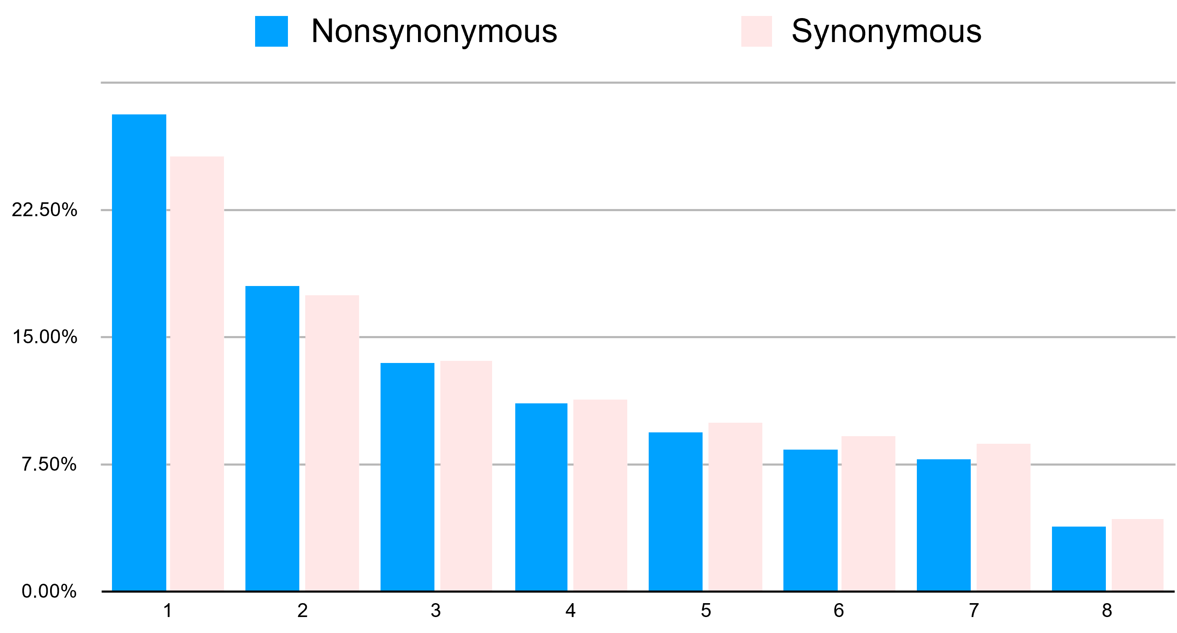
We use FitDadi to infer Selection
Notes:
However, demography is only party of the story. Next, we asked how selection might act differently on species in the human gut microbiome

Slide 47
We use FitDadi to infer Selection
Demography Linked selection Selection pressure
Demography
Linked selection
Notes:
We used a statistical inference package known as FitDadi (like Dadi, but fit) to infer selection. The major difference between Dadi and FitDadi is that FitDadi instead leverages the blue nonsynonymous site frequency spectrum to infer selection, conditional on demography, by treating the putatively neutral red synonymous sites as a reference for neutral evolution.
Include a short transition about how there’s some work (Bernard Kim 2017 Genetics) looking at the DFE in some Eukaryotes, but here we’re investigating

Slide 48
We use FitDadi to infer Selection
Demography Linked selection Selection pressure
Demography
Linked selection
Notes:
Quite nicely, if we condition on demography, and assume high enough recombination, then the unaccounted for primary evolutionary force acting on the nonsynonymous mutations is selection, which can be inferred

Slide 49
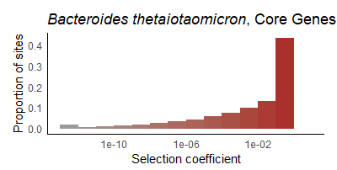
We infer the distribution of fitness effects (DFE)
Neutral
Deleterious
Notes:
Here I show the distribution of fitness effects, otherwise known as the DFE. This is a fundamental entity in genetics which describes the proportion of variants and to what extent selection acts on them.

Slide 50
We infer the distribution of fitness effects (DFE)
Neutral
Deleterious
Notes:
We can visualize this as a histogram in which the y-axis describes the proportion of sites

Slide 51
We infer the distribution of fitness effects (DFE)
Neutral
Deleterious
Notes:
We and the x-axis denotes whether mutations are more neutral or more deleterious. I’ve also color-coded the bars to correspond with lethality, with darker reds indicating highly deleterious mutations and lighter greys indicating neutral mutations

Slide 52
We infer the distribution of fitness effects (DFE)
Notes:
Want to see me do it again?

Slide 53
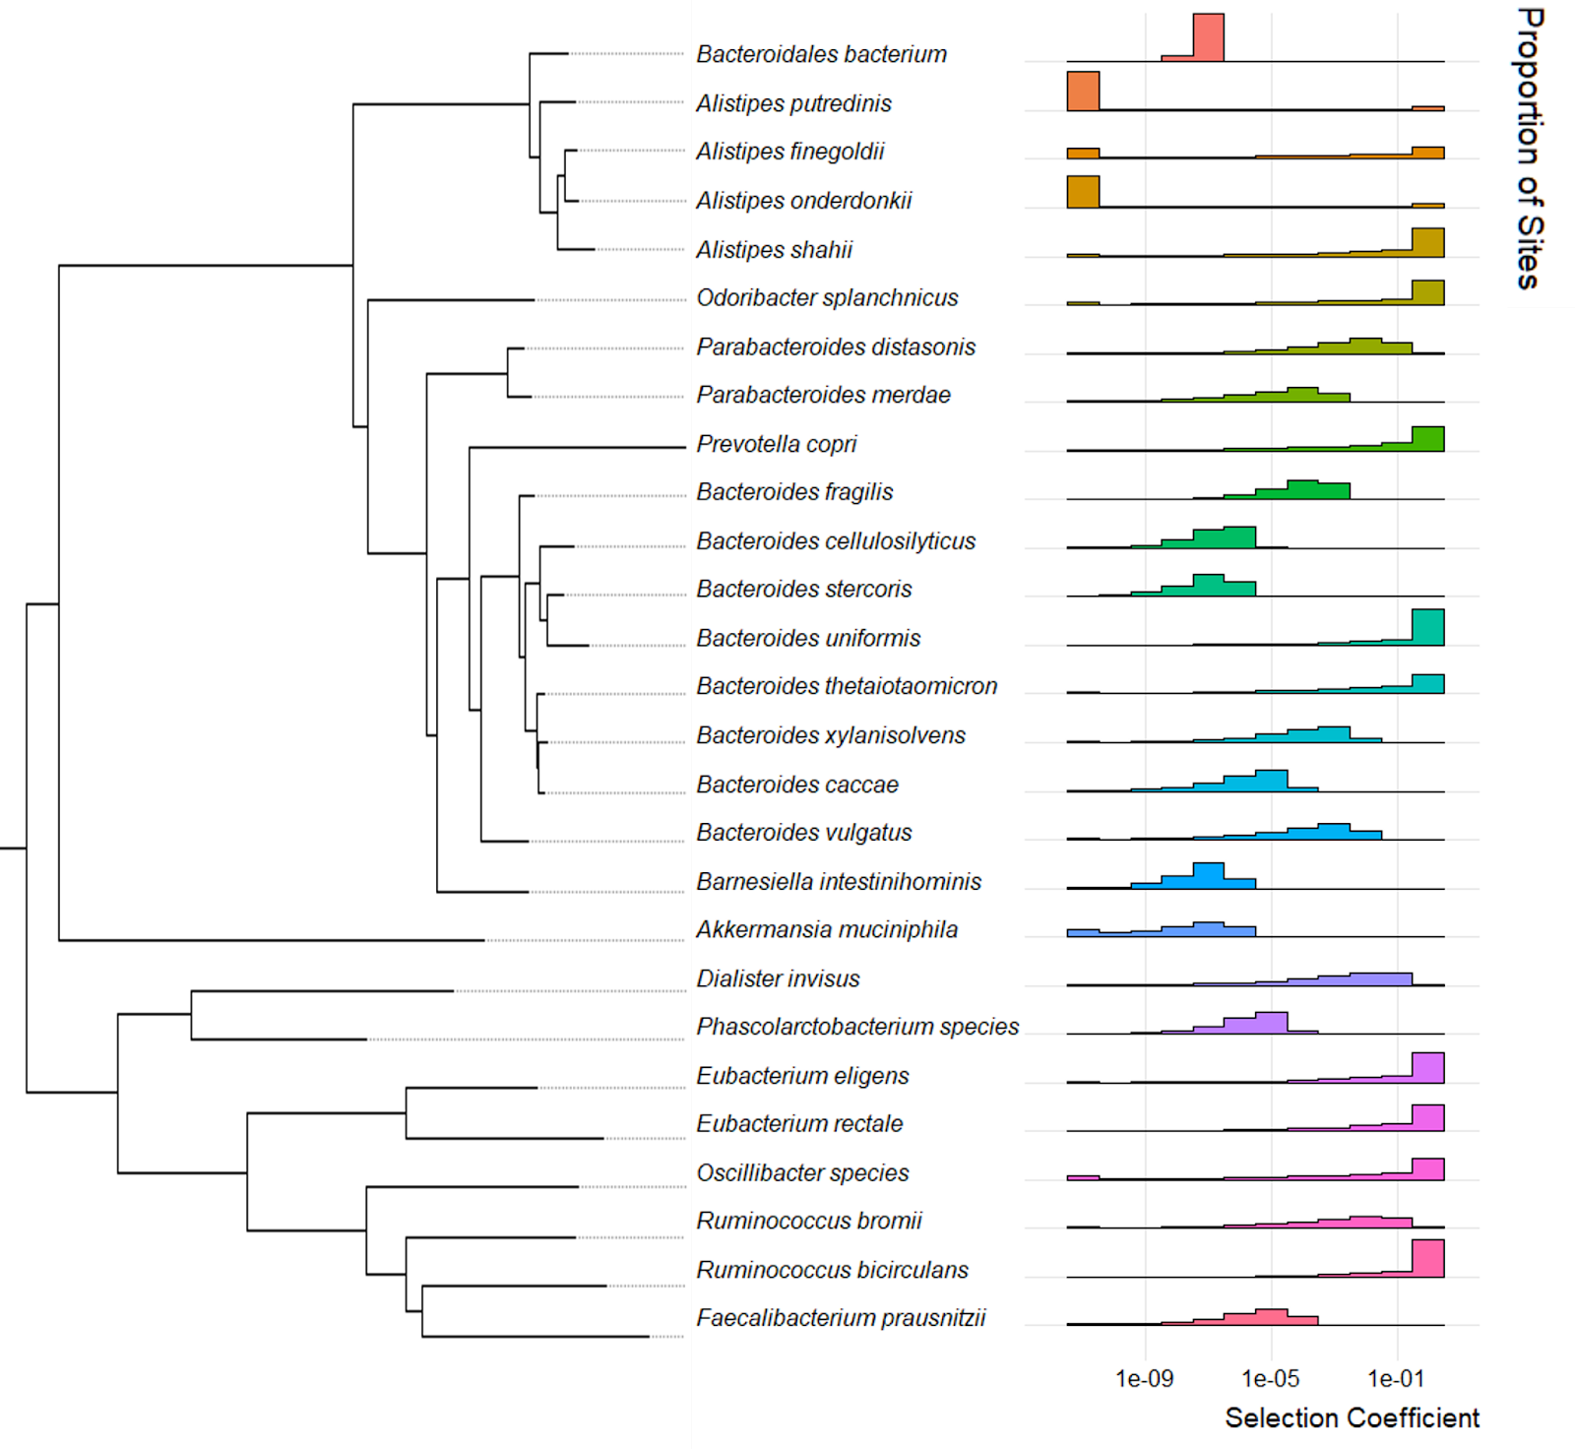
We infer varied distributions of fitness effects (DFE) across species
Notes:
We did, for 27 bacterial species simultaneously across the Human Gut Microbiome. Here I show a phylogenetically sorted panel of the distribution of fitness effects.

Slide 54
We infer varied distributions of fitness effects (DFE) across species
Notes:
I’d like to draw your eye towards some broad trends across genera. The Eubacterium genus, highlighted here on the bottom, tends to have extremely deleterious DFEs

Slide 55
We infer varied distributions of fitness effects (DFE) across species
Notes:
By contrast, the Bacteroides genus, highlighted here on the top, tends towards weakly or moderately deleterious DFEs providing some evidence of phylogenetic congruence for the DFE; however, overall, the story of the DFE is similar in nature to that of demography – each bacterial species has its own distinct evolutionary history.

Slide 56
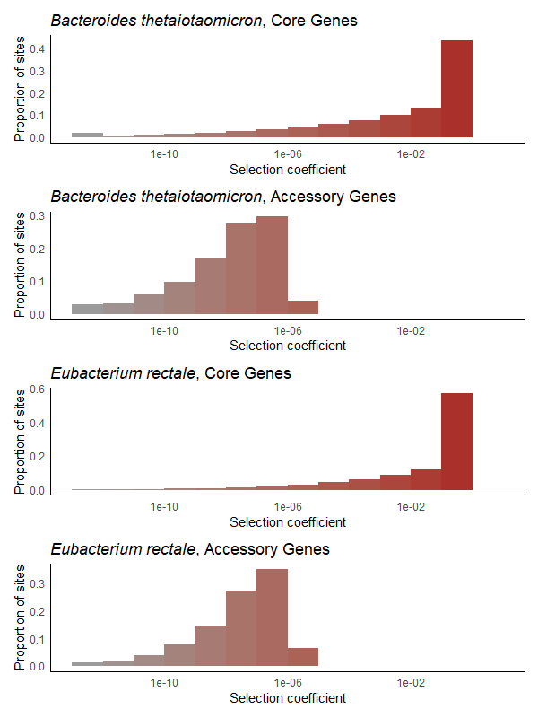
We infer varied distributions of fitness effects (DFE) within species
Notes:
Having found that the DFE varies across species, we next asked whether the DFE might vary within species

Slide 57
We study the Human Gut Microbiome
Notes:
Let’s revisit this cartoon from earlier

Slide 58
We study the Human Gut Microbiome
Core Genes
>=95% prevalence across hosts
Notes:
All of the analysis we’ve talked about so far has been over core genes, that is to say genes present in at least 95% of hosts.

Slide 59
We study the Human Gut Microbiome
Core Genes
>=95% prevalence across hosts
30%-70% prevalence across hosts
Accessory Genes
Notes:
However, there also exist accessory genes, which we define as genes present in between 30% and 70% of hosts. Quite importantly, accessory genes are known to typically encode for specific functions, such as antibiotic resistance, toxicity, and even specialized metabolic pathways for digestion.

Slide 60
We study the Human Gut Microbiome
Core Genes
>=95% prevalence across hosts
30%-70% prevalence across hosts
Accessory Genes
Notes:
We did this whole song and dance again, computed the site frequency spectrum, split it into synonymous and nonsynonymous mutations, inferred demography, and the distribution of fitness effects, but over accessory genes

Slide 61
Core genes have more deleterious DFEs than accessory genes
Notes:
Quite interestingly, in the species Bacteroides thetaiotaomicron, we find that the core genes have a more deleterious DFE than the accessory genes. I’d like to highlight again that the x-axis is on log10 scale, so selection acting on core genes is several magnitudes more deleterious than selection acting on accessory genes.

Slide 62
Core genes have more deleterious DFEs than accessory genes
Notes:
Wanna see me do it again?

Slide 63
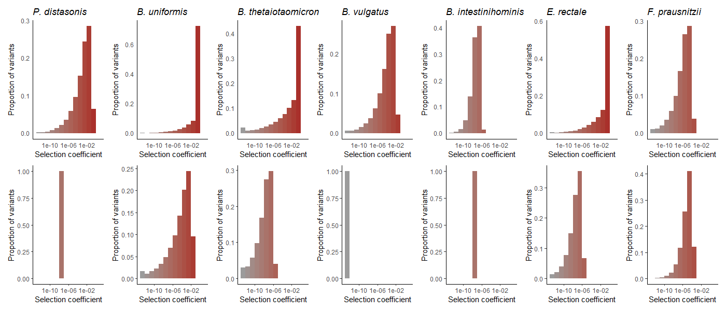

Core genes have more deleterious DFEs than accessory genes
Core Genes
Accessory Genes
Notes:
We did! For 7 bacterial species, simultaneously. Due to limitations of data paucity, we were unable to perform this analysis for all 27 species; however, of these 7,

Slide 64
We infer varied distributions of fitness effects (DFE) within species
Core Genes
Accessory Genes
Notes:
This difference in the DFE between core and accessory genes was found to be statistically significant in 5 out of 7 species when considering a null expectation incorporating effective population size, potentially suggestive of differences in the underlying population structure. Overall, we find a general trend across species in which core genes are subject to more deleterious selection than accessory genes.

Slide 65
Takeaways
Reduction of genetic diversity in North American guts
Notes:
In summary, our work recapitulates the observed reduction of genetic diversity in North American gut bacteria

Slide 66
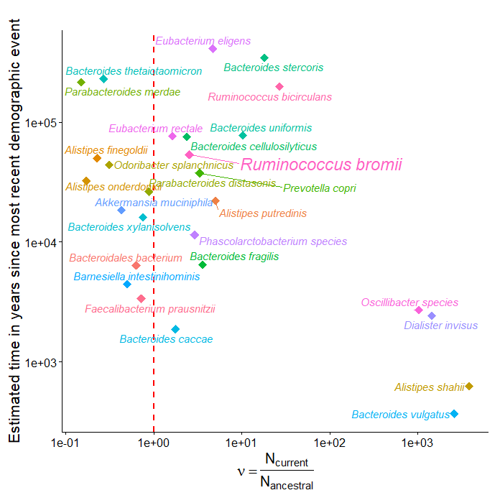

Takeaways
Reduction of genetic diversity in North American guts
Inference of varied demography and DFE in 27 species
Notes:
This study is the first known instance of leveraging the site-frequency spectrum to infer demography and selection in such a large number of species, which is particularly useful in elucidating the Prokaryotic branch of the tree of life

Slide 67
Takeaways
Reduction of genetic diversity in North American guts
Inference of varied demography and DFE in 27 species
Core genes have more deleterious DFEs than accessory genes
Notes:
Even within species, we found that different parts of the genome are subject to different levels of selection

Slide 68

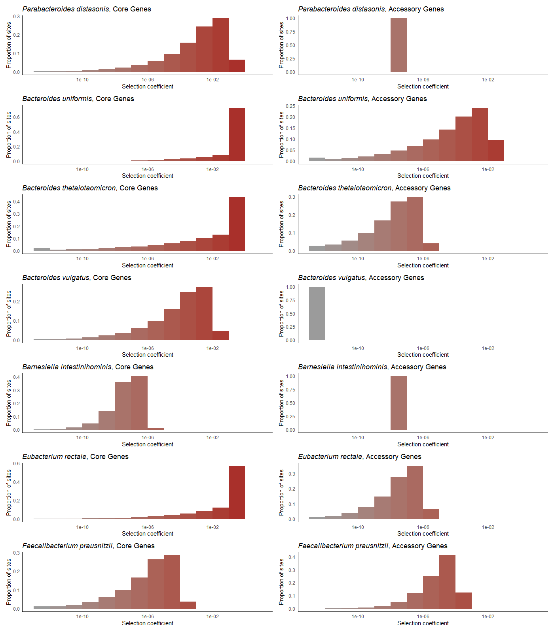
Takeaways
Reduction of genetic diversity in North American guts
Inference of varied demography and DFE in 27 species
Accessory genes have less deleterious DFEs than core genes
Future Work
Within-host DFE’s?
Notes:
A limitation of our approach is that our method of inferring the DFE can be considered as taking the “average” across hosts, however, finer-scale inference on a per-host basis could reveal exciting insights into personalized medicine

Slide 69



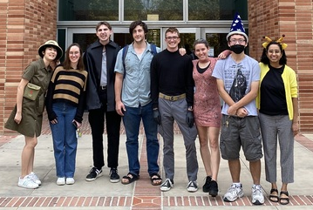







Many thanks to:
My colleagues in the Lohmueller and Garud groups for helpful discussions.
Heating
De'Longhi TRD40615E Full Room Radiant Heater (Kelvin)
Funding
NIGMS T32 5T32GM008185 (Systems in Integrative Biology)
Notes:
I’d like to acknowledge my many many wonderful colleagues for useful discussions, shown here on the left is the Lohmueller lab and shown here on the right is the Garud Lab.
I’d also like to thank our heater, we named it Kelvin
And lastly, this work was supported in part by funding from the Systems in Integrative Biology T32 training grant.

Slide 70
Many thanks to:
My colleagues in the Lohmueller and Garud groups for helpful discussions.
Heating
De'Longhi TRD40615E Full Room Radiant Heater (Kelvin)
Funding
NIGMS T32 5T32GM008185 (Systems in Integrative Biology)
Notes:
Additionally, all of my colleagues are super mega cool, but some of them are also presenting today. I’ve put a little gold star next to some of their faces – go talk to them

Slide 71



Questions?
Takeaways
Reduction of genetic diversity in North American guts
Inference of varied demography and DFE in 27 species
Core genes have more deleterious DFEs than accessory genes
Contact Information
Jonathan Mah, University of California, Los Angeles
@jonmah_compbio (maybe not this one oopsie woopsie)
@jonmah_compbio
jonmah@g.ucla.edu
Notes:
I’d like to thank you for your time and attention. Otherwise, I would be happy to take any questions if there are any, and if I don’t get to you, please feel free to reach me via this contact information!

Slide 72
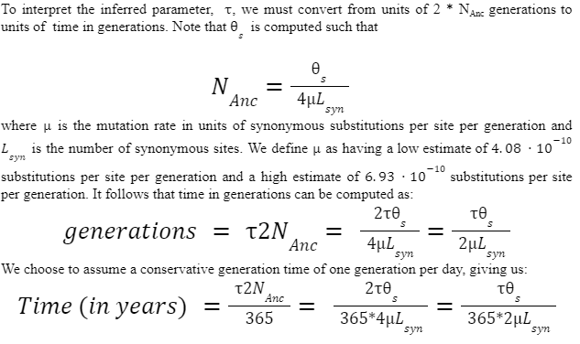
That’s a great question!

Slide 73
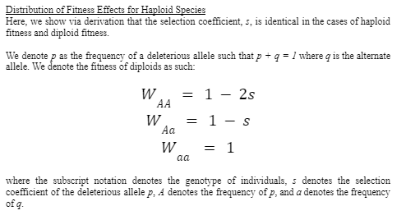
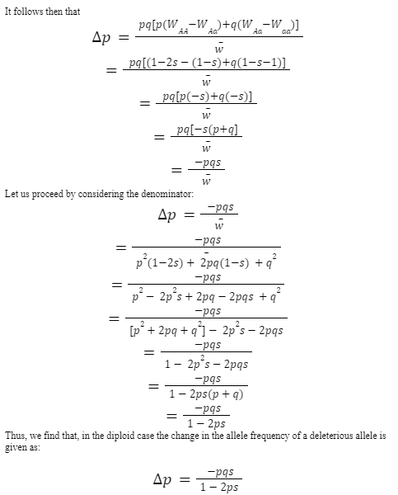
That’s a great question!

Slide 74
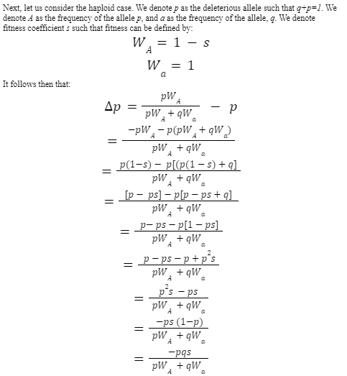
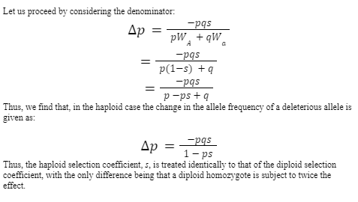
That’s a great question!

Slide 75
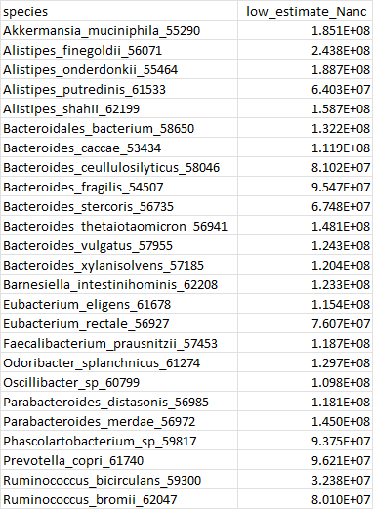
That’s a great question!

Slide 76
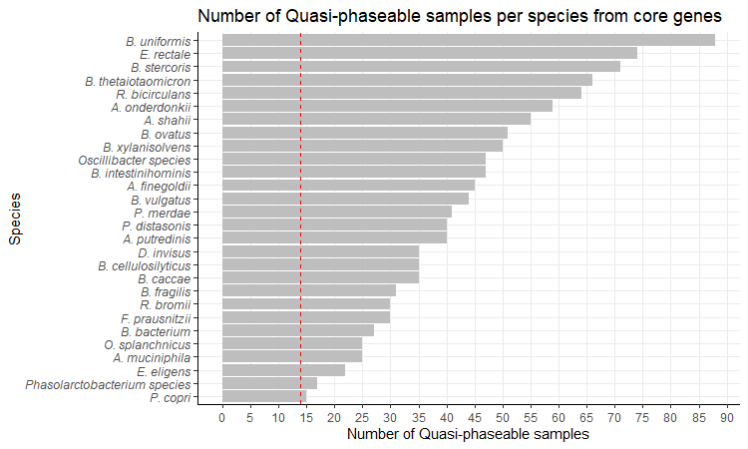
That’s a great question!
Notes:
471 Samples from 250 healthy hosts in North Americans – some of these were for 2 or 3 time points; however, we analyzed only a single timepoint per species per host

Slide 77
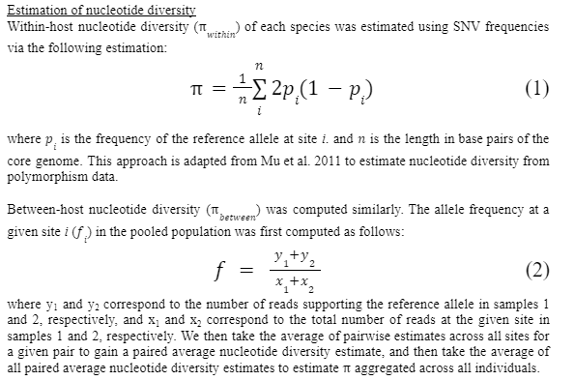
That’s a great question!

Slide 78
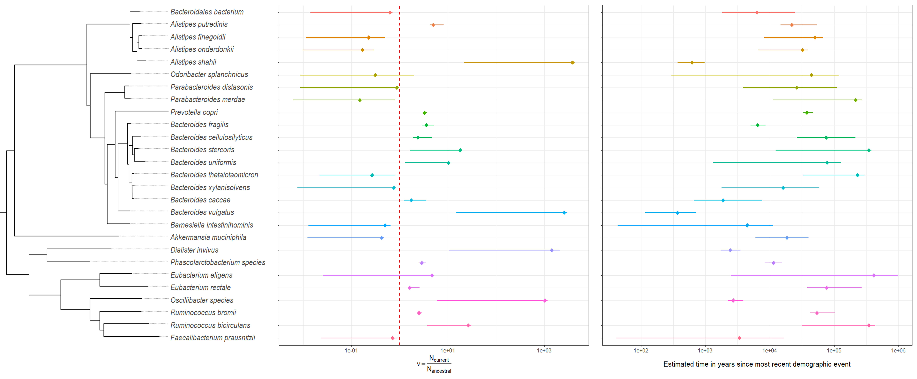
That’s a great question!
Notes:
Confidence intervals by species

Slide 79
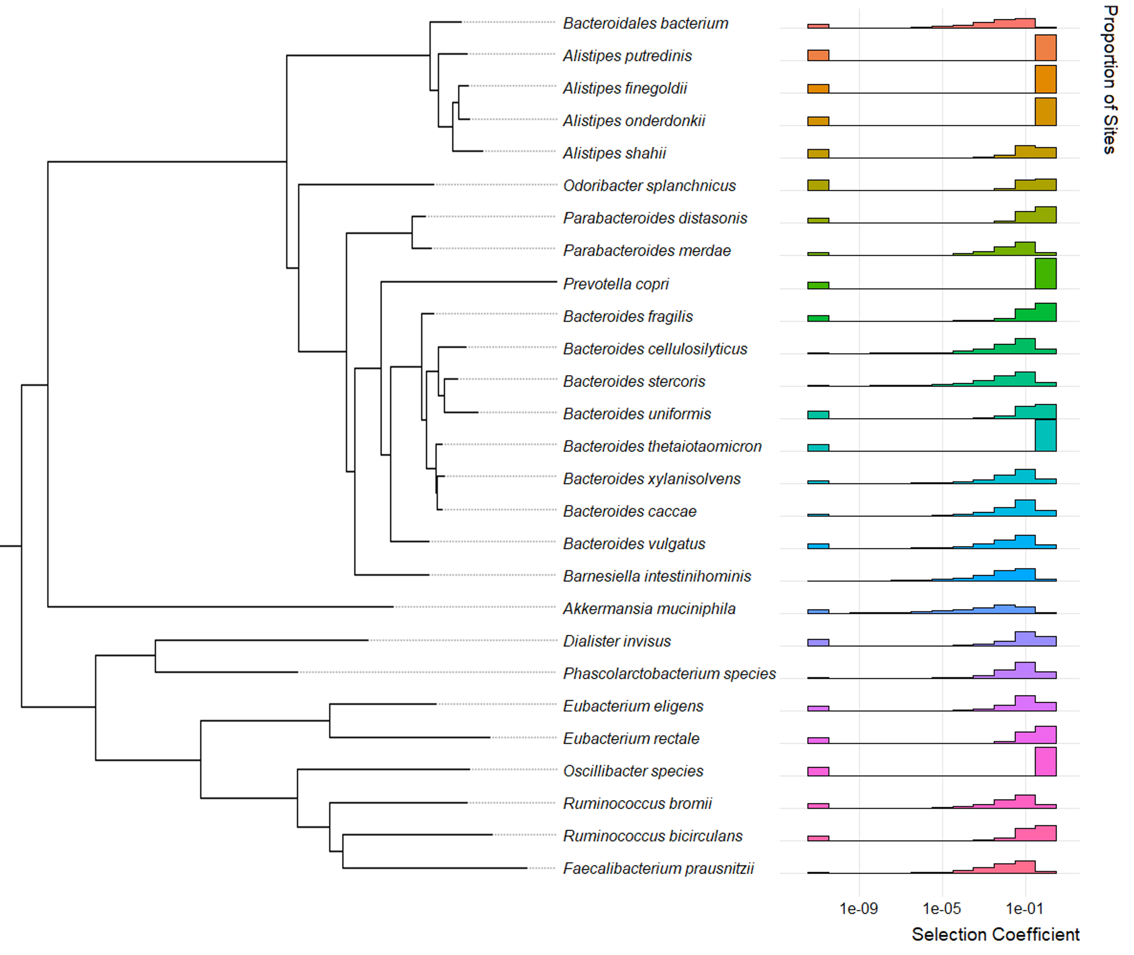
That’s a great question!
Notes:
Neutral+gamma DFE

Slide 80
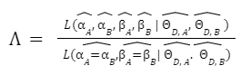
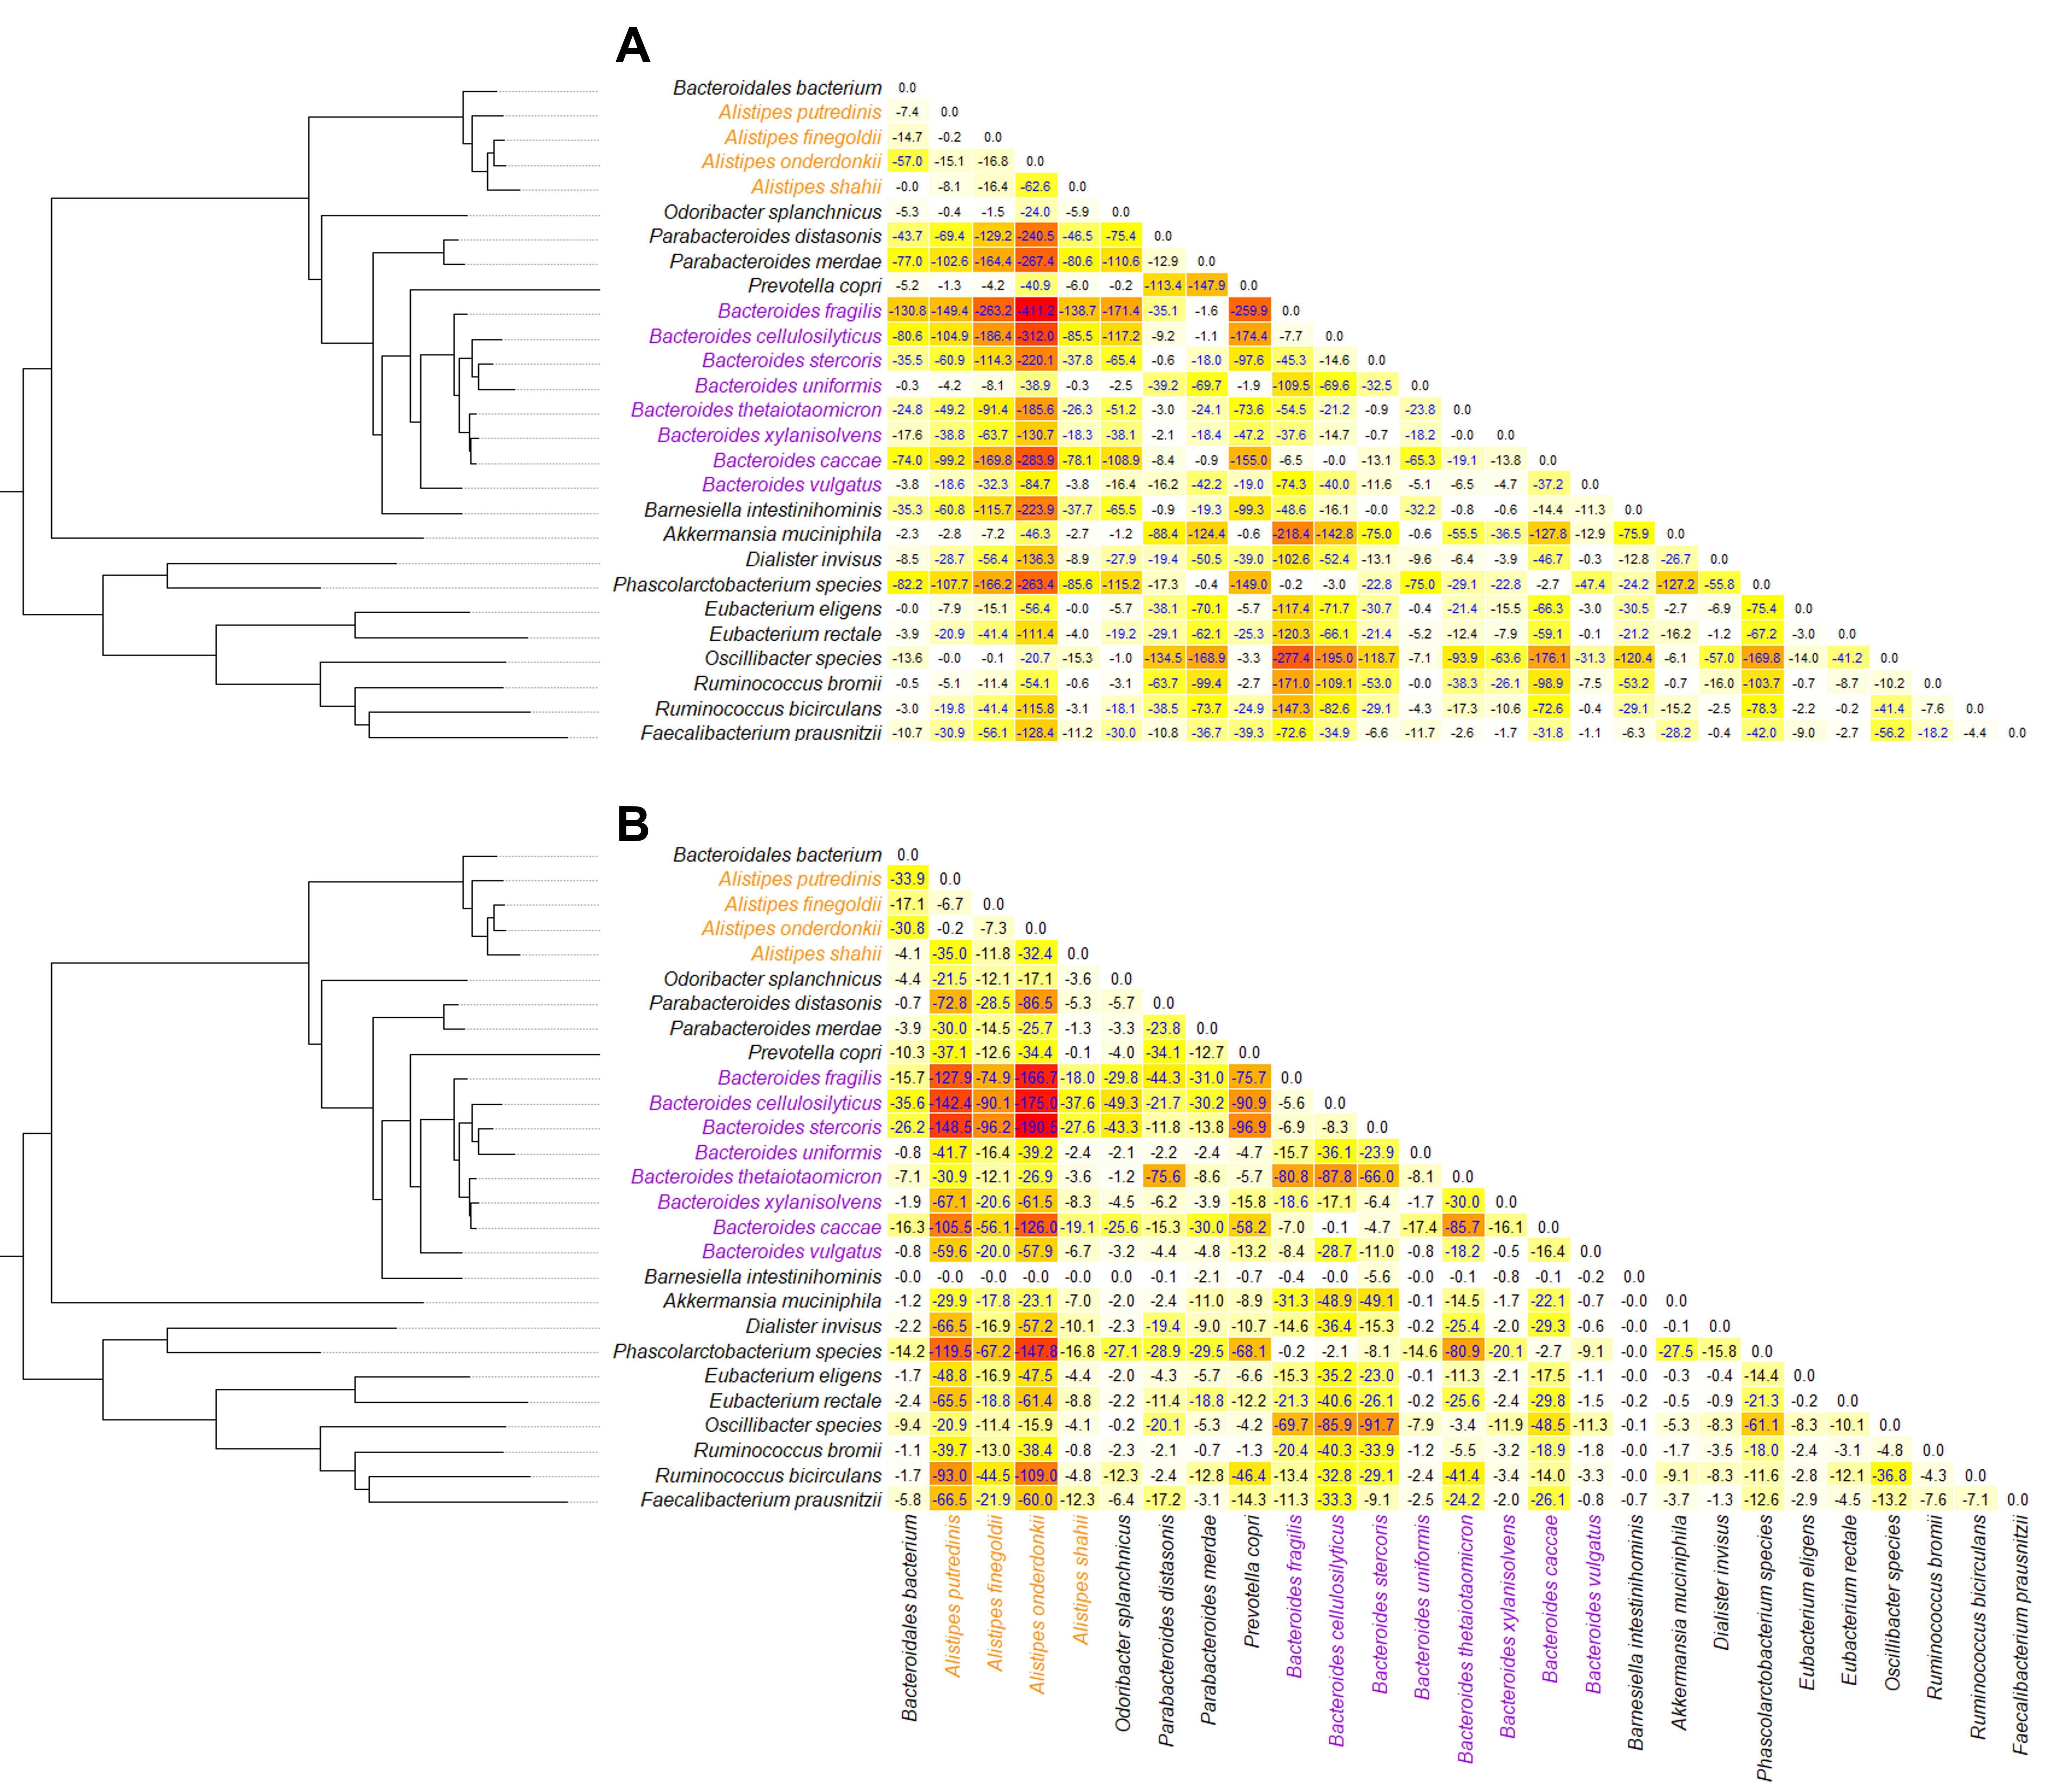
That’s a great question!
Selection coefficient, s
Population-scaled selection coefficient,
2N_{Anc}*s
Notes:
LRT across species

Slide 81
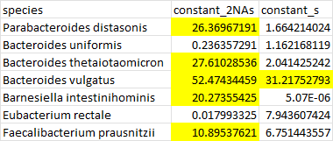
That’s a great question!
For 7 comparisons, the Bonferroni-corrected critical value is approximately 9.88
Notes:
LRT within species

Slide 82
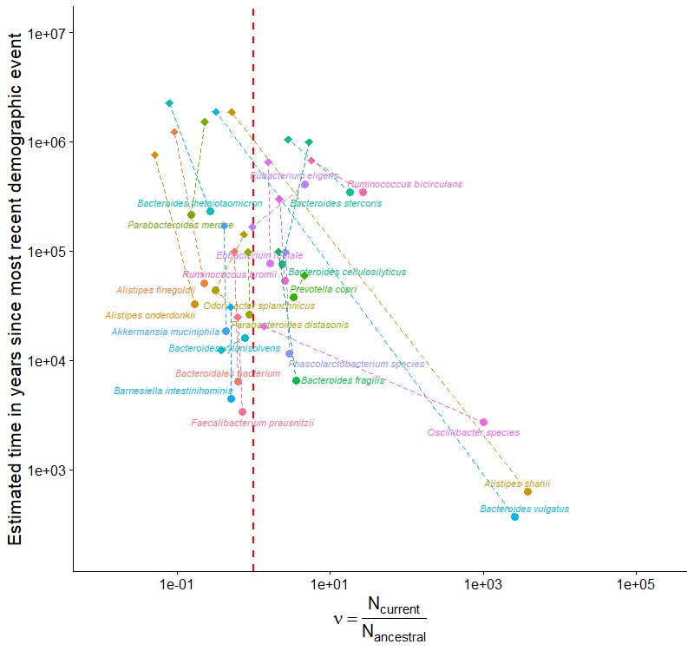
That’s a great question!
Notes:
Core genes vs. Core+Acc genes

Slide 83
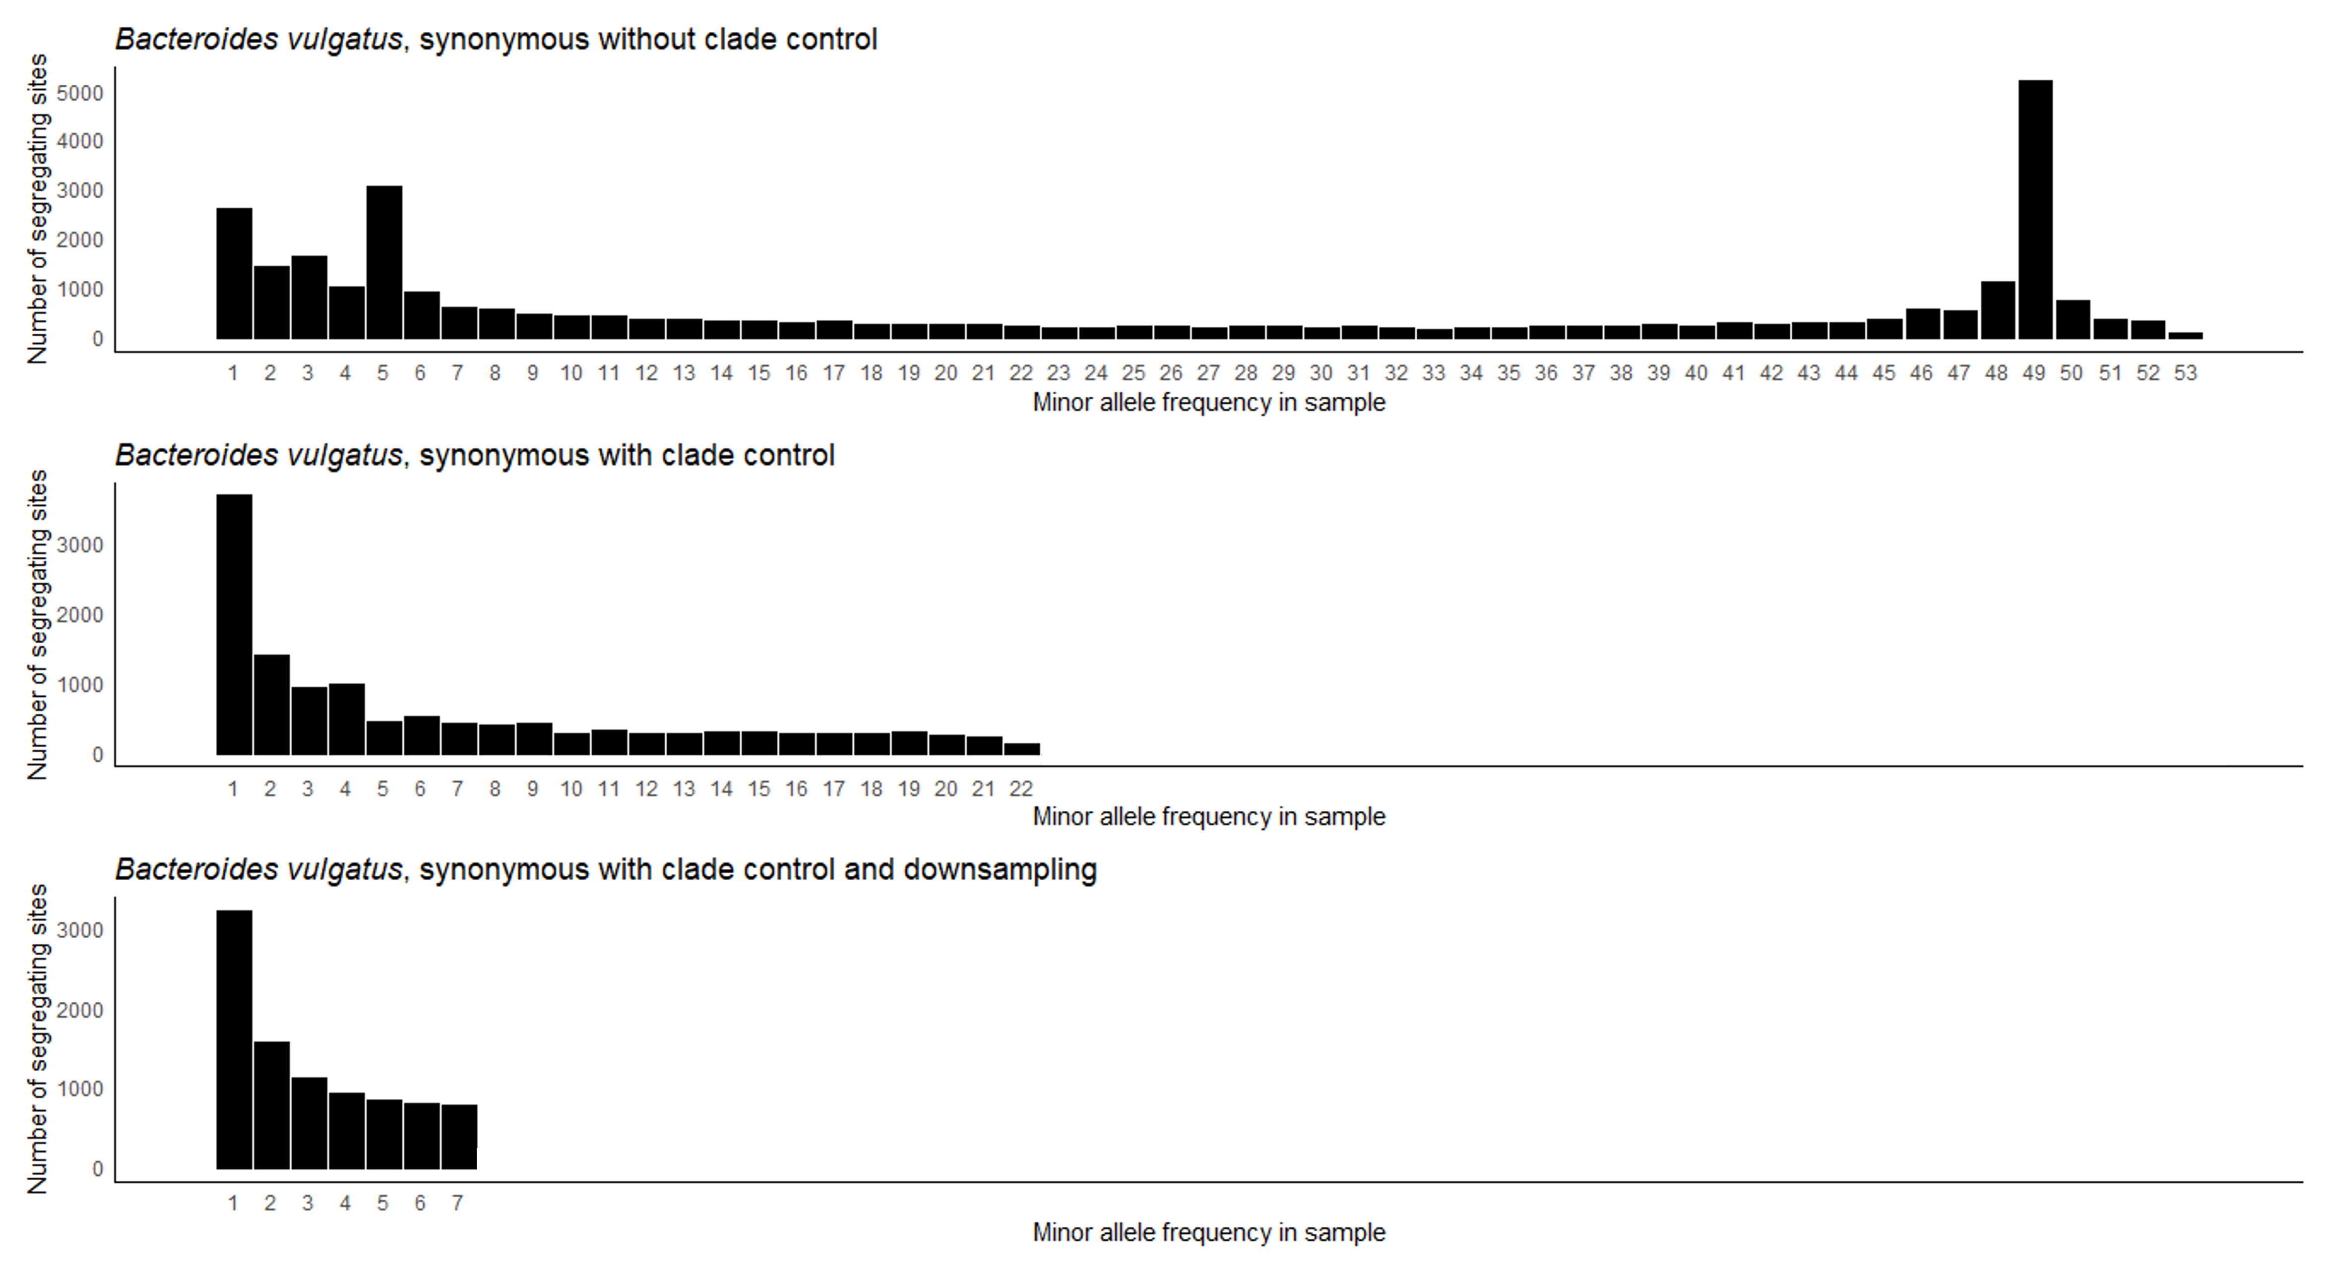
That’s a great question!

Slide 84
That’s a great question!

